Slide 1
Chapter 1 Fundamentals of Testing
Author: PVQuang

Slide 2
Content
1
What is Testing?
2
Why is Testing Necessary?
3
Seven Testing Principles
4
Test Process
5
The Psychology of Testing

Slide 3
1.1 What is Testing?
Testing: is the process of exercising or evaluating a system or system component by manual or automated means to verify that it satisfies specified requirements (IEEE)
Testing: the process consisting of all life cycle activities, both static and dynamic, concerned with planning, preparation and evaluation of software product and related work products to determine that they satisfy specified requirements, to demonstrate that they are fit for purpose and to detect defects (ISTQB glossary)

Slide 4
1.1 What is Testing?
Typical Objectives of Testing (K1):
To prevent defects by Evaluate Work Products
To verify whether all specified requirements have been fulfilled
To check whether the test object is complete and validate it
To build confidence in the level of quality of the test object
To find defects and failures
To provide sufficient information to stakeholders
To comply with contractual, legal, or regulatory requirements or standards, and/or to verify the test object’s compliance with such requirements or standards

Slide 5
1.1 What is Testing?
Typical Objectives of Testing (K1):
Example:
1. Which of the following is NOT a reasonable test objective?
A. To find faults in the software
B. To prove that the software has no faults
C. To give confidence in the software
D. To find performance problems

Slide 6
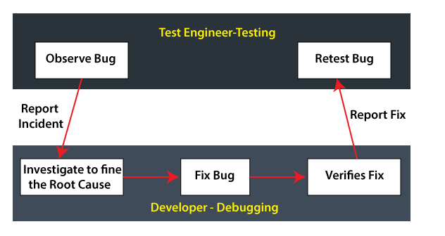
1.1 What is Testing?
Testing vs debugging (K2):

Slide 7
1.1 What is Testing?
Testing vs debugging (K2):
Example:
1. Which of the following is an example of debugging?
A. A tester finds a defect and reports it
B. A developer finds and fixes a defect
C. A tester retests a fix from the developer and finds a regression
D. A developer performs unit testing

Slide 8


1.2 Why is Testing Necessary?
In May 1992, Pepsi fan a promotion in the Philippines.
Customers could win a million pesos (approx. $40,000) if they bought a bottle of Pepsi and found number 349 stamped on the underside of the bottle cap.
Unfortunately, due to a software error, 800,000 bottle caps were produced with number 349 instead of one, which was an equivalent of $32 billion in prize money.
What was originally earmarked to be a promotion with $2 million in total prizes ballooned to $10 million.

Slide 9
1.2 Why is Testing Necessary?
How testing contributes to higher quality? (K2):
Being involved in requirements reviews or user story refinement could detect defects in these work products.
Working together with system designers while the system is being designed can increase each party’s understanding of the design and how to test it.
Working together with developers while the code is under development can increase each party’s understanding of the code and how to test it.
Verify and validate the software prior to release can detect failures that might otherwise have been missed, and support the process of removing the defects that caused the failures (i.e., debugging)

Slide 10
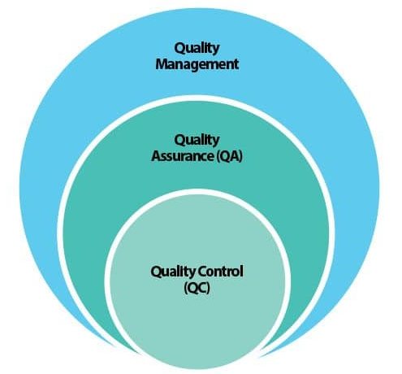
1.2 Why is Testing Necessary?
Quality Assurance and Testing (K2):
QA is typically focused on adherence to proper processes, provide confidence that the appropriate levels of quality will be achieved
QC involves various activities, including test activities, support the achievement of appropriate levels of quality
=> QA and testing are not the same, but they are related.

Slide 11
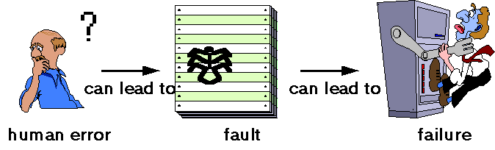
1.2 Why is Testing Necessary?
Error, defect, and failure (K2):
Error (mistake): A human action that produces an incorrect result.
Defect (fault/bug): An imperfection or deficiency in a work product where it does not meet its requirements or specifications. The result of an error.
Failure: An event in which a component or system does not perform a required function within specified limits.

Slide 12
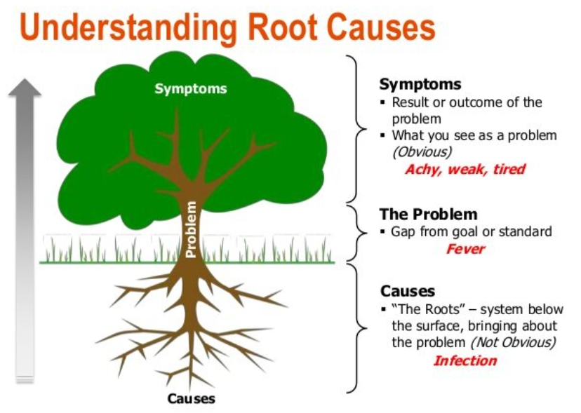
1.2 Why is Testing Necessary?
Root Causes of Defect and their Effects (K2):
Root causes of defects are the earliest actions or conditions that contributed to creating the defects
Identify root causes -> reduce the occurrence of similar defects in the future/prevent degrade defects
Effect: The result of the defects

Slide 13
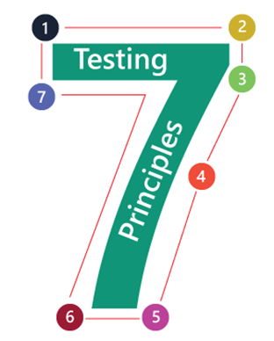
1.3 Seven Testing Principles
Testing shows the presence of defects, not their absence
Exhaustive testing is impossible
Early testing saves time and money
Absence-of-errors is a fallacy
Defects cluster together
Testing is context dependent
Beware of the pesticide paradox

Slide 14
1.4 Test Process
Test Process in Context (K2):
Contextual factors:
SDLC model and project methodologies being used
Test levels and test types being considered
Product and project risks
Business domain
Operational constraints, including but not limited to: Budgets and resources, Timescales, Complexity, Contractual and regulatory requirements
Organizational policies and practices
Required internal and external standards

Slide 15
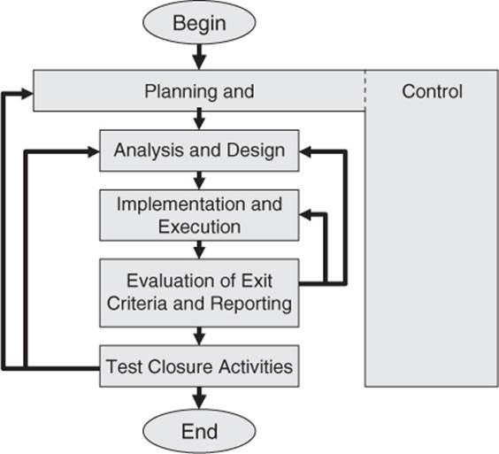
1.4 Test Process
Test Activities and Tasks (K2):
A test process consists of the following main groups of activities:
Test planning
Test monitoring and control
Test analysis
Test design
Test implementation
Test execution
Test completion

Slide 16
1.4 Test Process
Test planning (K2) has some major tasks:
Determine the scope and risks and identify the objectives of testing
Determine the test approach (techniques, test items, coverage, identifying and interfacing with the teams involved in testing)
Implement the test policy and/or the test strategy
Determine the required test resources (e.g. people, test environment, PCs)
Schedule test analysis and design tasks, test implementation, execution and evaluation
Determine the exit criteria

Slide 17
1.4 Test Process
Test monitoring and control (K2) has some major tasks:
Measure & analyze the testing results
Monitor and document progress, test coverage and exit criteria
Provide information on testing
Initiate corrective actions: tighten exit criteria, add resource to fix, priority defect to fix
Make decisions

Slide 18
1.4 Test Process
Test analysis (K2) has some major tasks:
Analyzing the test basis appropriate to the test level being considered
Evaluating the test basis and test items to identify defects such as:
+ Ambiguities
+ Omissions
+ Inconsistencies
+ Inaccuracies
+ Contradictions
+ Superfluous statements
Identifying features and sets of features to be tested

Slide 19
1.4 Test Process
Test analysis (K2) has some major tasks:
Defining and prioritizing test conditions for each feature based on:
+ Analysis of the test basis
+ Considering functional, non-functional and structural characteristics
+ Business and technical factors
+ Levels of risks
Capturing bi-directional traceability between each element of the test basis and the associated test conditions

Slide 20
1.4 Test Process
Test design (K2) has some major tasks:
Designing and prioritizing test cases and sets of test cases
Identifying necessary test data to support test conditions and test cases
Designing the test environment and identifying any required infrastructure and tools
Capturing bi-directional traceability between the test basis, test conditions, and test cases

Slide 21
1.4 Test Process
Test implementation (K2) has some major tasks:
Developing and prioritizing test procedures/automated test scripts
Creating test suites from the test procedures/automated test scripts
Arranging the test suites within a test execution schedule in a way that results in efficient test execution
Building the test environment (including, potentially, test harnesses, service virtualization, simulators, and other infrastructure items) and verifying that everything needed has been set up correctly

Slide 22
1.4 Test Process
Test implementation (K2) has some major tasks:
Preparing test data and ensuring it is properly loaded in the test environment
Verifying and updating bi-directional traceability between the test basis, test conditions, test cases, test procedures, and test suites

Slide 23
1.4 Test Process
Test execution (K2) has some major tasks:
Recording the IDs and versions of the test item(s) or test object, test tool(s), and testware
Executing tests either manually or by using test execution tools
Comparing actual results with expected results
Analyzing anomalies to establish their likely causes (e.g., failures may occur due to defects in the code, but false positives also may occur
Reporting defects based on the failures observed

Slide 24
1.4 Test Process
Test execution (K2) has some major tasks:
Logging the outcome of test execution (e.g., pass, fail, blocked)
Repeating test activities either as a result of action taken for an anomaly, or as part of the planned testing (e.g., execution of a corrected test, confirmation testing, and/or regression testing)
Verifying and updating bi-directional traceability between the test basis, test conditions, test cases, test procedures, and test results.

Slide 25
1.4 Test Process
Test completion (K2) has some major tasks:
Checking whether all defect reports are closed, entering change requests or product backlog items for any defects that remain unresolved at the end of test execution
Creating a test summary report to be communicated to stakeholders
Finalizing and archiving the test environment, the test data, the test infrastructure, and other testware for later reuse

Slide 26
1.4 Test Process
Test completion (K2) has some major tasks:
Handing over the testware to the maintenance teams, other project teams, and/or other stakeholders who could benefit from its use
Analyzing lessons learned from the completed test activities to determine changes needed for future iterations, releases, and projects
Using the information gathered to improve test process maturity

Slide 27
1.4 Test Process
Test Process | Test Work Products
Test planning | Test Plans
Test monitoring and control | Test progress reports Test summary reports Test Management Report (task completion, resource allocation and usage, and effort)
Test analysis | Test conditions (defined and prioritized)
Test design | Test cases Test data Design of the test environment Identification of infrastructure and tools
Test implementation | Test procedures (+sequencing) Test suites Test execution schedule
Test execution | Test result/Test status: ready to run, pass, fail, blocked… Defect reports Documentation about which test item(s), test object(s), test tools, and testware were involved in the testing
Test completion | Test summary reports Action items for improvement of subsequent projects or iteration Change requests or product backlog items Finalized testware.

Slide 28
1.4 Test Process
Traceability between the Test Basis and Test Work Products (K2):
Traceability enables: + Analyzing the impact of changes
+ Making testing auditable
+ Meeting IT governance criteria
+ Improving the understand ability of test progress reports and test summary reports to include the status of elements of the test basis (e.g., requirements that passed their tests, requirements that failed their tests, and requirements that have pending tests)

Slide 29
1.4 Test Process
Traceability between the Test Basis and Test Work Products (K2):
Traceability enables: + Relating the technical aspects of testing to stakeholders in terms that they can understand
+ Providing information to assess product quality, process capability, and project progress against business goals

Slide 30
1.5 The Psychology of Testing
Human Psychology and Testing (K1):
An element of human psychology called confirmation bias can make it difficult to accept information that disagrees with currently held beliefs.
Some ways to communicate well:
+ Start with collaboration and teamwork rather than battles
+ Stay objective and factual, not focused on the person
+ Try to understand how the other person feels and the reasons they may react negatively to the information
+ Be sure the other person understood what you have said

Slide 31
1.5 The Psychology of Testing
Tester’s and Developer’s Mindsets (K2):
Tester’s mindset: curiosity, professional pessimism, a critical eye, attention to detail, and a motivation for good and positive communications and relationships. A tester’s mindset tends to grow and mature as the tester gains experience
Developer’s mindset: often more interested in designing and building solutions than in contemplating what might be wrong with those solutions

Slide 32
Terms/Glossary
Test basis: All documents from which the requirements of a component or system can be inferred. The documentation on which test cases are based.
Test condition: An item or event of a component or system that could be verified by one or more test cases, e.g. a function, transaction, feature, quality attribute, or structural element.
Test case: A set of input values, execution preconditions, expected results, and execution post conditions developed for a particular objective or test condition, such as to exercise a particular program path or to verify compliance with a specific requirement
Test plan: A document describing the scope, approach, resources, and schedule of intended test activities

Slide 33
Terms/Glossary
Test planning: The activity of establishing or updating a test plan
Test control: A test management task that deals with developing and applying a set of corrective actions to get a test project on track when monitoring shows a deviation from what was planned
Test Approach: the implementation of the test strategy for a specific project.
Testware: includes test cases, test plans, test data, etc..
Test strategy: A high-level description of the test types to be performed and the testing for a program (one or more projects)
Test policy: A high level document describing the principles, approach and major objectives of the organization regarding testing

Slide 34


